Slide 1
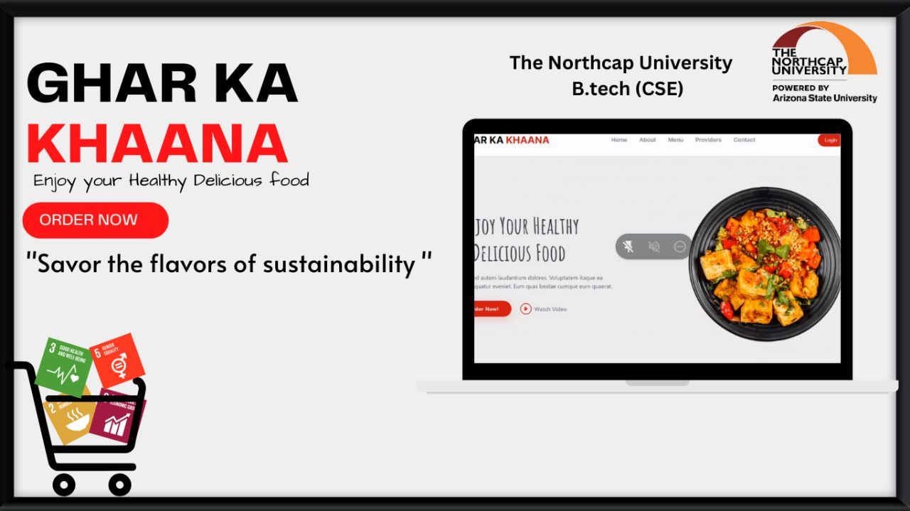


By : Shivani Saluja (19csu294)
Shreya Sureka (19csu299)
Ishita Bhatia (19csu138)
Gitansha Madan (19csu114)
Faculty Mentors: Dr Yogita Gigras
Dr Mehak Khurana

Slide 2


Introduction
This project is particularly for ordering homemade cooked food direct from home chefs (service providers). Our project connects customers to home chefs mostly Housewives and encouraging them to use their culinary skills to make money, offering a convenient and flexible job opportunity and food to the customers at minimum price while promoting healthy lifestyle.
The purpose of this program is to benefit the user in addition to a homemade meal maker and to establish women's empowerment. We created a system that would serve customers meals like lunch and dinner based on their preferences and geolocation. It will also include Happy Hours and first user offer is also there where on first order 70% discount will be there for customers."

Slide 3

PROBLEMS
UNAVAILABILITY OF HEALTHY AND AFFORDABLE
HOME MADE FOOD
Relocation due to job or education, people find it difficult to find healthy home-made food at an affordable price.
NO-TIME TO COOK
Unconventional Millennial lifestyle where people don’t have time to cook
Often leads to bad eating habits.
PERSONALISED DIET
People who have dietary or medical issues.
.

Slide 4
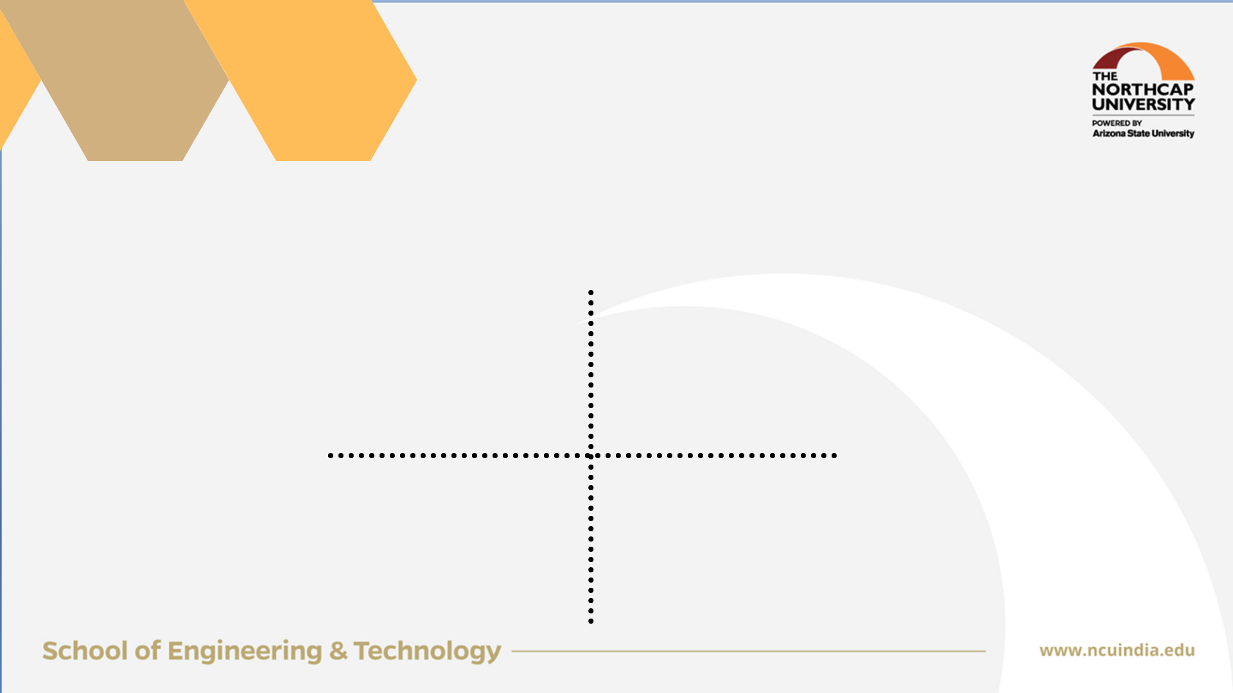




SOLUTIONS / TECHNOLOGY USED
SOLUTIONS
NUTRITIOUS DIET:
Healthy, hygienic homemade food at your doorsteps
TECHNOLOGY:
1.React.js (Frontend)
2.Backend(NodeJS, Express and Python)
3. Database(MySQL)
Connecting customers to home chefs mostly Housewives and encouraging them to use their culinary skills to make money, offering a convenient and flexible job opportunity and food to the customers at min. price while promoting healthy lifestyle
PERSONALIZED MEAL
NUTRITIOUS DIET
PERSONALIZED DIET: Customized Food
Just like home kitchen where we can customize your meal as per our taste & preference.
It aims to improve the health and well-being of customers by providing a variety of fresh, nutritious meals and dietary options
ORGANIC VEGETABLES
HYGIENIC FOOD
HAPPY HOURS
Clean cooking environment , considering high quality and freshness of food is maintained .
Geo-location Tracking
Recommendation System
HAPPY HOURS
Happy hours will feature discounts on the meals that will be accessible for a certain period.

Slide 5
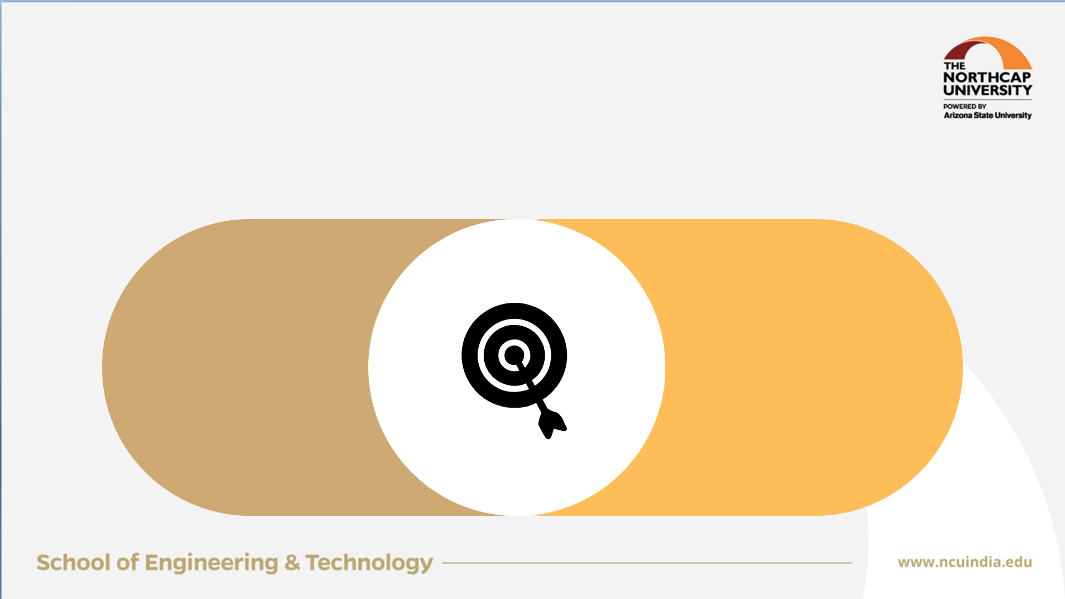
SOLUTIONS / TECHNOLOGY USED
SOLUTINS
MISSION & VISION
NUTRITIOUS DIET:
Healthy, hygienic homemade food at your doorsteps
TECHNOLOGY:
1.React.js (Frontend)
2.BackendodeJS, Express and Python)
3. Database(MySQL)
PERSONALIZED MEAL
NUTRITIOUS DIET
PERSONALIZED DIET: Customized Food
To create a platform that connects customers with high-quality, home-cooked meals while providing flexible job opportunities for individuals such as housewives
To become the leading provider of home-cooked meals and a go-to platform for the customer. It aims to establish a strong reputation and brand as a trusted and reliable source of delicious and healthy meals
Just like home kitchen where we can customize your meal as per our taste & preference.
It aims to improve the health and well-being of customers by providing a variety of fresh, nutritious meals and diy options
The vision for the tiffin service app would be to become the leading provider of home-cooked meals and a go-to platform
ORGANIC VEGETABLES
ORGANIC VEGETABLES
HAPPY HOURS
Geo-location Tracking
Recommendation System
Providing organic vegetables to our customers and service providers at minimum price
Happy hours will feature discounts on the meals that will be accessible for a certain period.
HAPPY HOURS

Slide 6
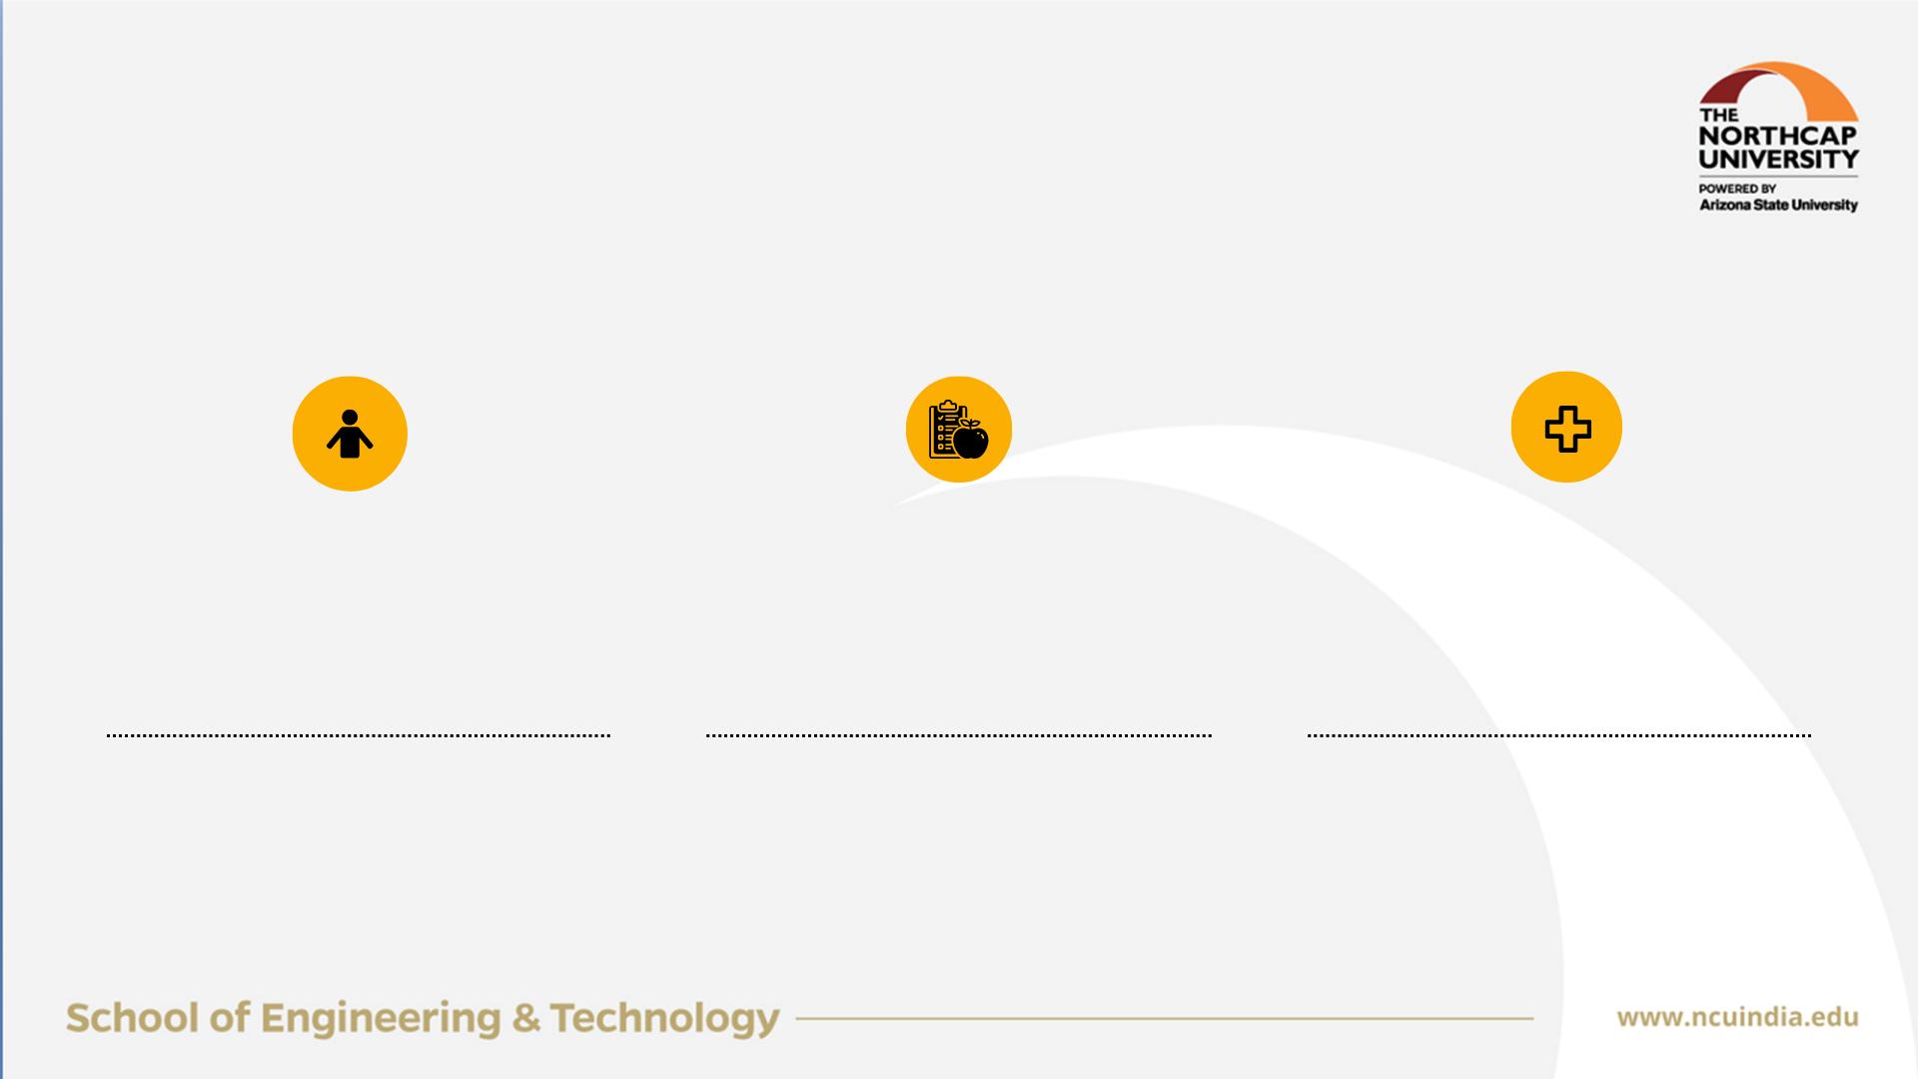
CUSTOMER SEGMENT
Students and Individuals who are living alone
Dietary Restrictions
Medical Restrictions
Students and individuals living alone who do not have time to cook
Customers who have dietary restrictions such as gluten-free, vegetarian or vegan
Customers who have medical issue based on their health for eg:- someone who has diabetes or is allergic to something

Slide 7
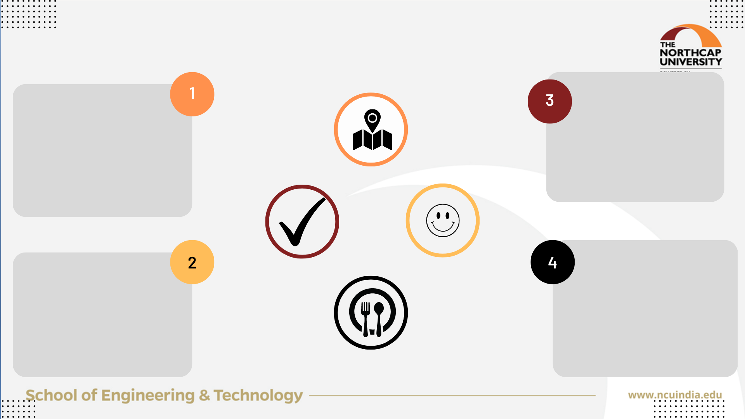
CUSTOMER SEGMENT
UNFAIR ADVANTAGE
LOCATION WISE PROVIDERS
RANDOM CHECKS
To connect customers with cooks in their local area
faster and more efficient delivery, fresher food
lower delivery costs
Randomly checking the service providers work environment to ensure hygiene and quality
Students and Individuals who are living alone
Dietary Restrictions
Medical Restrictions
PERSONALIZED MEAL
HAPPY HOURS
Students and individuals living alone who do not have time to cook
Customers who have medical issue based on their health for eg:- someone who has diabetes or is allergic to something
Providing additional discounts at a certain time to the customers
Customers who have dietary restrictions such as gluten-free, vegetarian or vegan
Personalized & customized meals for someone who have dietary or medical restrictions

Slide 8


GAP ANALYSIS
MARKET RESEARCH
HOME CHEF ONBOARDING
USER EXPERIENCE
GEOLOCATION AND PREFERENCES
QUALITY CONTROL
MARKETING AND PROMOTION
PRICING AND PROFITABILITY
SCALABILITY AND EXPANSION

Slide 9
1
QUALITY CONTROL
2
ISSUES AND CHALLENGES
SUPPLY AND DEMAND
3
DELIEVERY LOGISTICS
4
SCALING OPERATIONS
5
MARKETING AND COMPETITION
6
TRUST AND SAFETY
7
REGULATORY AND COMPLIANCE
8
FINANCIAL VIABILITY

Slide 10
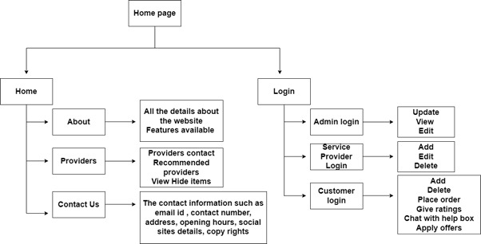
DESIGN METHOLOGY

Slide 11
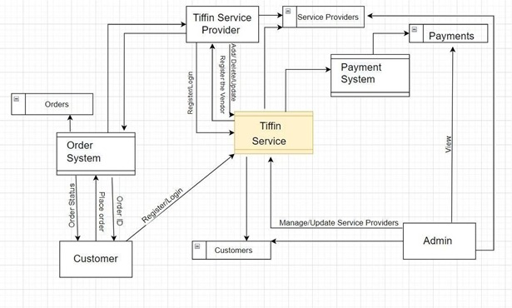

Slide 12
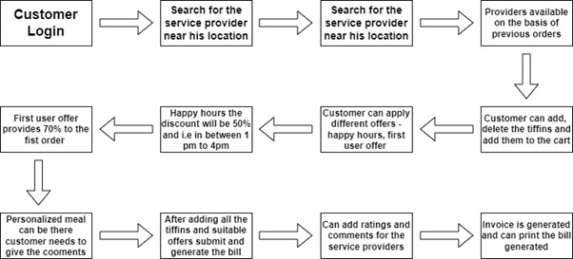

Slide 13
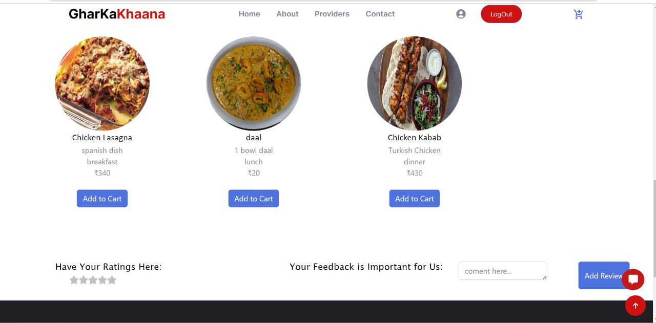
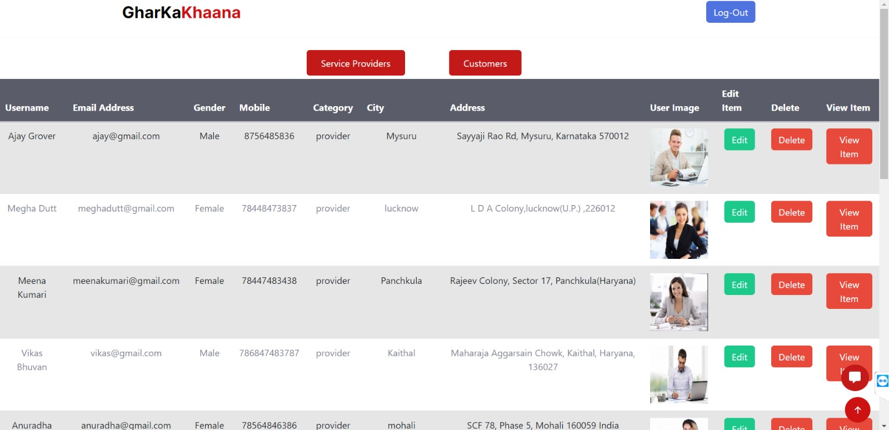
INTERFACE
Admin view – Admin can edit, delete the information of service providers
Service Providers can add their tiffins and edit all the items

Slide 14
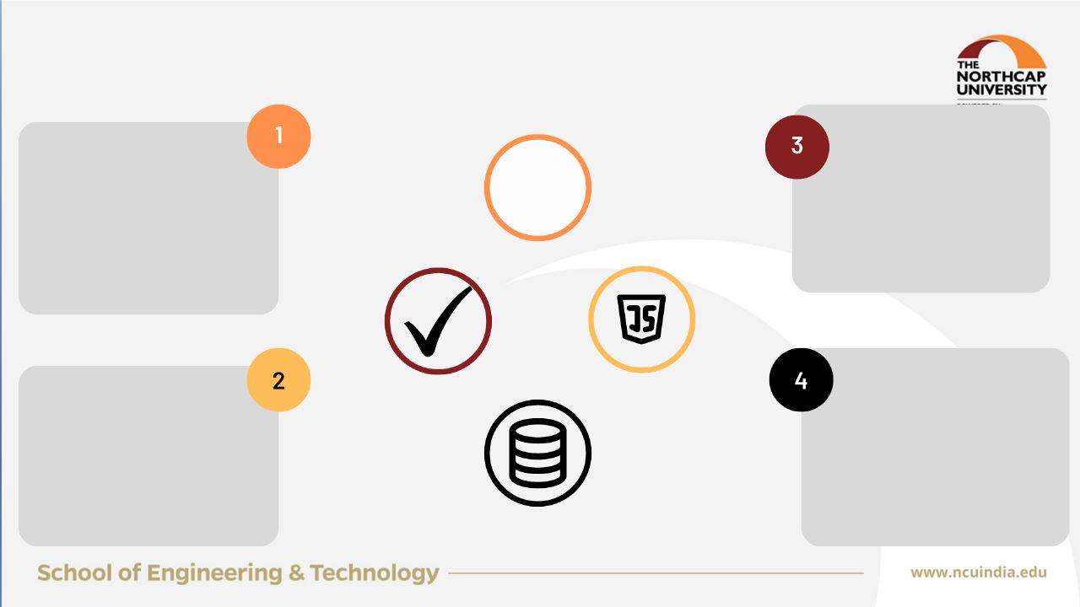

TECHNOLOGY USED
LOCATION WISE PROVIDERS
Recommendation System
To connect customers with cooks in their local area
faster and more efficient delivery, fresher food
lower delivery costs
Website will recommend according to the customers reviews and views.
DATABASE
TECH STACK
React.js (Frontend)
NodeJS, Express
My SQL
Database for tiffin service and login are used

Slide 15
TESTING
Test Strategy
Documentation in our report include topics
Introduction
References
Test Management
Scope of testing
Test Plan
Documentation in our report include topics
Scenario
Excepted Result
Latest Result
Automated
Acceptance Criteria
Performance Testing:
The website should load quickly on different devices and browsers.
The website should be able to handle multiple user requests simultaneously.
The website should be able to handle peak traffic loads without any errors.
The website should be able to provide a smooth user experience without any delays or errors.
We will be using REACT testing library to test our website.
Functionality Testing:
The user should be able to place an order for a tiffin service without any errors.
The user should be able to select the type of tiffin service (Veg/Non-veg) and quantity.
The user should be able to add any special instructions or notes.
The website should show the total cost of the order accurately.
The user should be able to select the payment method (Debit card, Credit card, or Online banking) without any errors.
The user should be able to enter the payment details without any errors.
The website should show the payment confirmation accurately.
The user should be able to select the delivery address without any errors.
The website should show the estimated delivery time accurately.
The user should be able to track the delivery status without any errors.
The user should be able to cancel the order without any errors.
Usability Testing:
The website should be easy to use and navigate without any errors.
The website should have a consistent layout and design.
The website should be responsive on different devices and browsers.
The website should have proper error messages and alerts that guide the user.
The website should have clear instructions for the ordering process.

Slide 16
TECHNOLOGY USED
CHANNELS
LOCATION WISE PROVIDERS
Recommendation System
WEBSITE
Website will be our main channel of communication and marketing.
OFFLINE MARKETING
Putting up posters, flyers, brochures and ads in public places like supermarkets, bus-stops, and universities
EMAIL MARKETING
Sending out newsletters, promotional offers and updates to customers who have subscribed to the website's email list.
To connect customers with cooks in their local area
faster and more efficient delivery, fresher food
lower delivery costs
Website will recommend according to the customers reviews and views.
SOCIAL MEDIA
We will use social media platform to connect with our consumer segments, this will build our brand and increase our sales.
ONLINE ADVERTISING
Running targeted ads on search engines and social media to reach potential customers who are looking for food delivery services.
REFERRAL MARKETING
Encouraging existing customers to refer their friends and family to the website.
DATABASE
TECH STACK
React.js (Frontend)
NodeJS, Express and Python (Backend)
My SQL
Database for tiffin service and login are used

Slide 17
FOCUSS PARAMETERS
FOCUSS Parameters | Description
FINANCIAL VIABILITY | Target market is primarily students and young working professionals so the prices will be cheaper The quality of the food and service is exceptional to ensure customer satisfaction and loyalty. Consistency in taste, quality will be crucial to building a loyal customer base. Our website is user-friendly and efficient
ORIGINALITY/INNOVATIVENESS | Approach of connecting customers to home chefs and promoting women's empowerment through the use of culinary skills. Focus on providing wholesome, homemade meals at a minimum price Health and Hygiene Inexpensive food Website having added features Random Checks Packaging – wooden spoons/forks , cloth bag

Slide 18
FOCUSS Parameters | Description
CUSTOMER ACCEPTABILITY | Highly acceptable to customers offers homemade cooked food, which is different from the ready-made food available in the market, The use of local home chefs to prepare the meals will add a personalized touch to the service and attract customers looking for authentic home-cooked meals. Convenience of ordering through the internet, personalized meal options based on preferences and geolocation, and the inclusion of Happy Hours with 50% off offers
USEFULNESS TO SOCIETY | Provides access to healthy and wholesome meals Provides job opportunities for home chefs Encourages healthy eating habits Provides convenience Promotes sustainability

Slide 19
FOCUSS Parameters | Description
SUSTAINABILITY | By encouraging home chefs, mostly housewives Promoting homemade meals The project can contribute to reducing food waste and encouraging sustainable food consumption By serving meals based on the customer's location
STRUCTURED APPROACH | Market research Business planning Website development Chef recruitment Operations and logistics Performance tracking and improvement

Slide 20
EXISTING ALTERNATIVES
Watscooking
HomeCooked
HomeFoodi
Their focus is more on traditional home-cooked meals
Their target audience is those with a full schedule and no time to prepare their own meal.
Based and operating in the UK They offer quality dishes prepared with the highest standards of hygiene.
HomeFoodi’s aim is to make that experience affordable, accessible, and appetizing.
Masala Box
Corporate Dhaba
Spice Box
Masala Box blends cleanliness, accessibility, and financial security with the benefits of warm, fresh cuisine.
Its USP is that you only need to establish preferences once, then promptly at mealtime, additive-free food keeps arriving on your table.
In Delhi NCR, Corporate Dhaba offers delivery for lunch and dinner and has a tasty menu planned out for the week.
It holds that meals should be healthful, hygienic, enticing, and enjoyable.
Ordering food on the website should take less than two minutes.
They have a policy of cancellation, and credits are returned to users' wallets.

Slide 21
TECHNOLOGY USED
CHANNELS
COST STRUCTURE
LOCATION WISE PROVIDERS
Recommendation System
WEBSITE
Website will be our main channel of communication and marketing.
OFFLINE MARKETING
Putting up posters, flyers, brochures and ads in public places like supermarkets, bus-stops, and universities
EMAIL MARKETING
Sending out newsletters, promotional offers and updates to customers who have subscribed to the website's email list.
DELIVERY COST
Website will recommend according to the customers reviews and views.
To connect customers with cooks in their local area
faster and more efficient delivery, fresher food
lower delivery costs
25 % to be paid to the delivery person
1
PACKAGING COST
2
APP AND WEBSITE DEVELOPMENT
SOCIAL MEDIA
We will use social media platform to connect with our consumer segments, this will build our brand and increase our sales.
15% to be paid to the
Mass- produced
REFERRAL MARKETING
Encouraging existing customers to refer their friends and family to the website.
ONLINE ADVERTISING
Running targeted ads on search engines and social media to reach potential customers who are looking for food delivery services.
3
5
5% of the cost will be spent of app development, website and marketing.
DATABASE
TECH STACK
4
RANDOM CHECKS
10% to be paid to the individuals.
My SQL
Database for tiffin service and login are used
React.js (Frontend)
NodeJS, Express and Python (Backend)
OTHERS
5% All other miscellaneous needs to be taken care of.

Slide 22
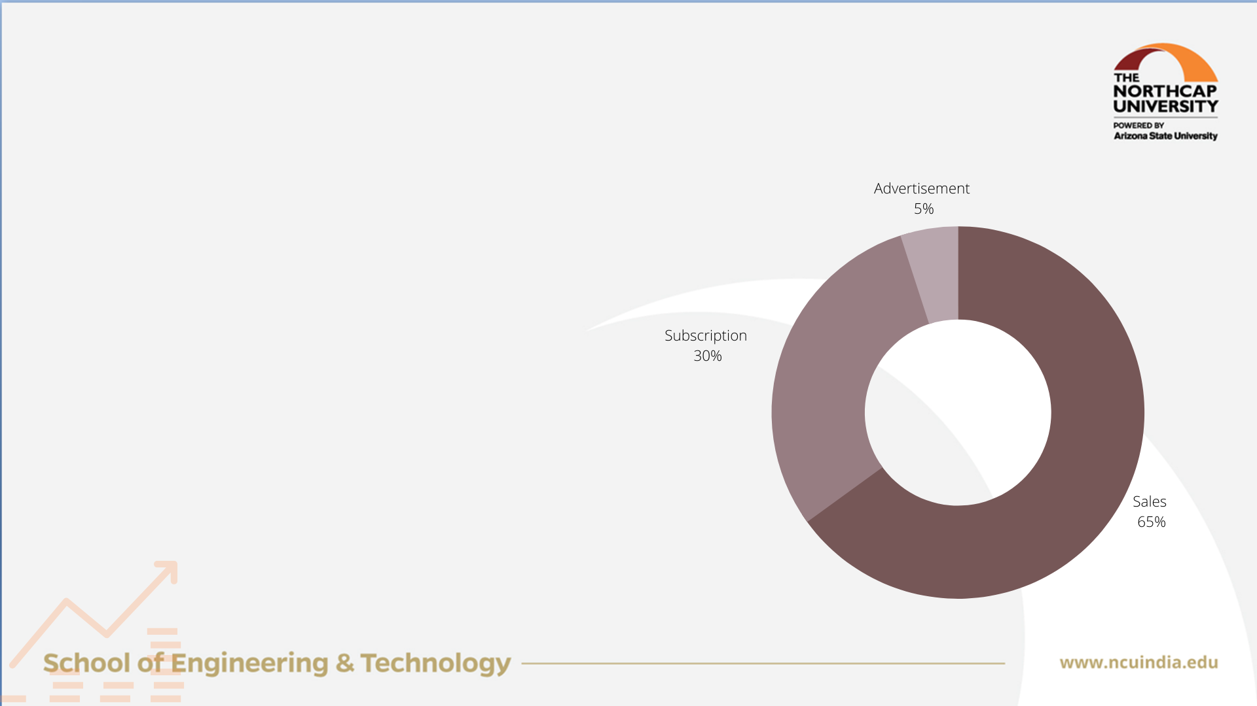
TECHNOLOGY USED
CHANNELS
REVENUE
COST STRUCTURE
LOCATION WISE PROVIDERS
Recommendation System
WEBSITE
Website will be our main channel of communication and marketing.
OFFLINE MARKETING
Putting up posters, flyers, brochures and ads in public places like supermarkets, bus-stops, and universities
EMAIL MARKETING
Sending out newsletters, promotional offers and updates to customers who have subscribed to the website's email list.
DELIVERY COST
SALES
15- 20 % from the service providers.
This will be negotiable after a certain period
SUBSCRIPTION PLAN
The Website will also generate revenue from subscription or membership fees.
ONLINE AD REVENUE
The Website may also generate revenue from advertising and sponsorships
Website will recommend according to the customers reviews and views.
To connect customers with cooks in their local area
faster and more efficient delivery, fresher food
lower delivery costs
25 % to be paid to the delivery person
1
PACKAGING COST
2
APP AND WEBSITE DEVELOPMENT
SOCIAL MEDIA
We will use social media platform to connect with our consumer segments, this will build our brand and increase our sales.
15% to be paid to the
Mass- produced
REFERRAL MARKETING
Encouraging existing customers to refer their friends and family to the website.
ONLINE ADVERTISING
Running targeted ads on search engines and social media to reach potential customers who are looking for food delivery services.
3
5
5% of the cost will be spent of app development, website and marketing.
DATABASE
TECH STACK
4
RANDOM CHECKS
10% to be paid to the individuals.
My SQL
Database for tiffin service and login are used
React.js (Frontend)
NodeJS, Express and Python (Backend)
OTHERS
5% All other miscellaneous needs to be taken care of.

Slide 23

HACKATHON PARTICIPATION
"Ideation Competition on Sustainable Lifestyle" was organized by Aryabhatt DSEU Ashok Vihar Campus from 3rd February to 10th February and we secured 4th position and were in the top winners.
“ASU” Start-Up Idea Competition with Impacting Community through Sustainable Innovations theme from 20th – 25th Feb. 2023 and we secured 3rd position and were in the top winners.
"5th Technovation HACKATHON " held by Sharda University from 30th jan – 4th feb and we qualified 2 rounds of the competition.
The World Engineering Day (WED) for Sustainable Development is celebrated on the 4th of March every year as a UNESCO international day promoting the profile of engineers and engineering. The 2023 World Engineering Day theme is ‘Engineering Innovation for a More Resilient World’.

Slide 24
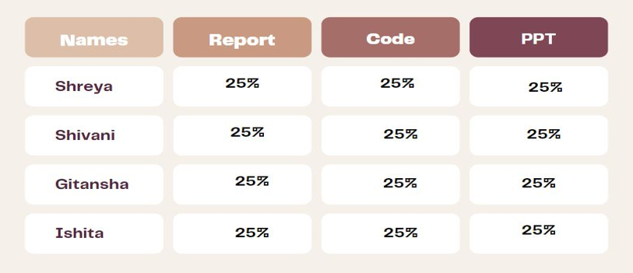
RESPONSIBILITY CHART

Slide 25
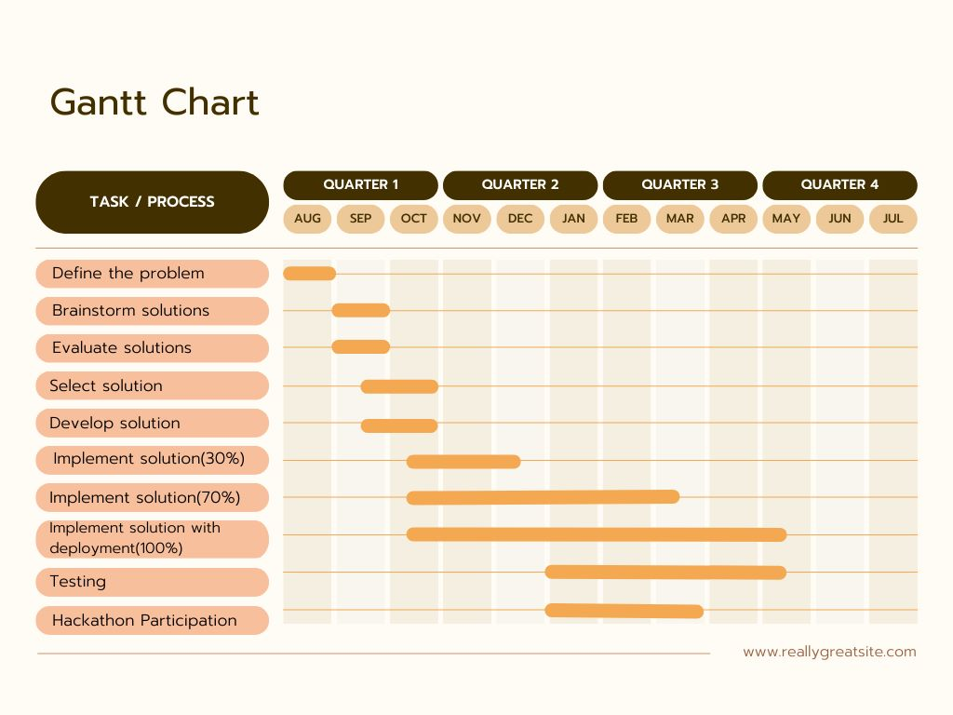

Slide 26
